Slide 1
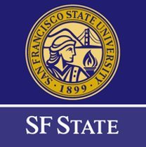
Welcome!
2024 Academic Internships Webinar
Tell us your name, what school you're from, and why you're interested in an internship!
Answer in the chat box (bottom of your screen) 💬
Notes:
Elsa and Becca: Hi Everyone! Welcome in - thank you for joining us today for the Academic Internship Informational Webinar. While we're waiting for folks to join us, please tell us your name, what school you're from, and why you're interested in an internship in the chat box at the bottom of your screen. Or, if you already know which internship position you're interested in, feel free to put that in the chat as well. We'll get started in about 5 mins at 2:35. Panelists – if you'd like to introduce yourselves as well in the chat, that would be great! Your name, your organization, and what position you'll be talking about today
Elsa: Alright, we're going to go ahead and get started! So, again, welcome to the Academic Internships Informational Webinar. We will be recording this webinar, just so everyone knows. To start with some intros, my name is Elsa, and I'm the Program Manager of Park Internships with the Golden Gate National Parks Conservancy. My colleague Becca is here with me as well and I'll let her introduce herself....
(Becca introduces and passes to Denise to introduce herself; Denise passes back to Elsa)

Slide 2
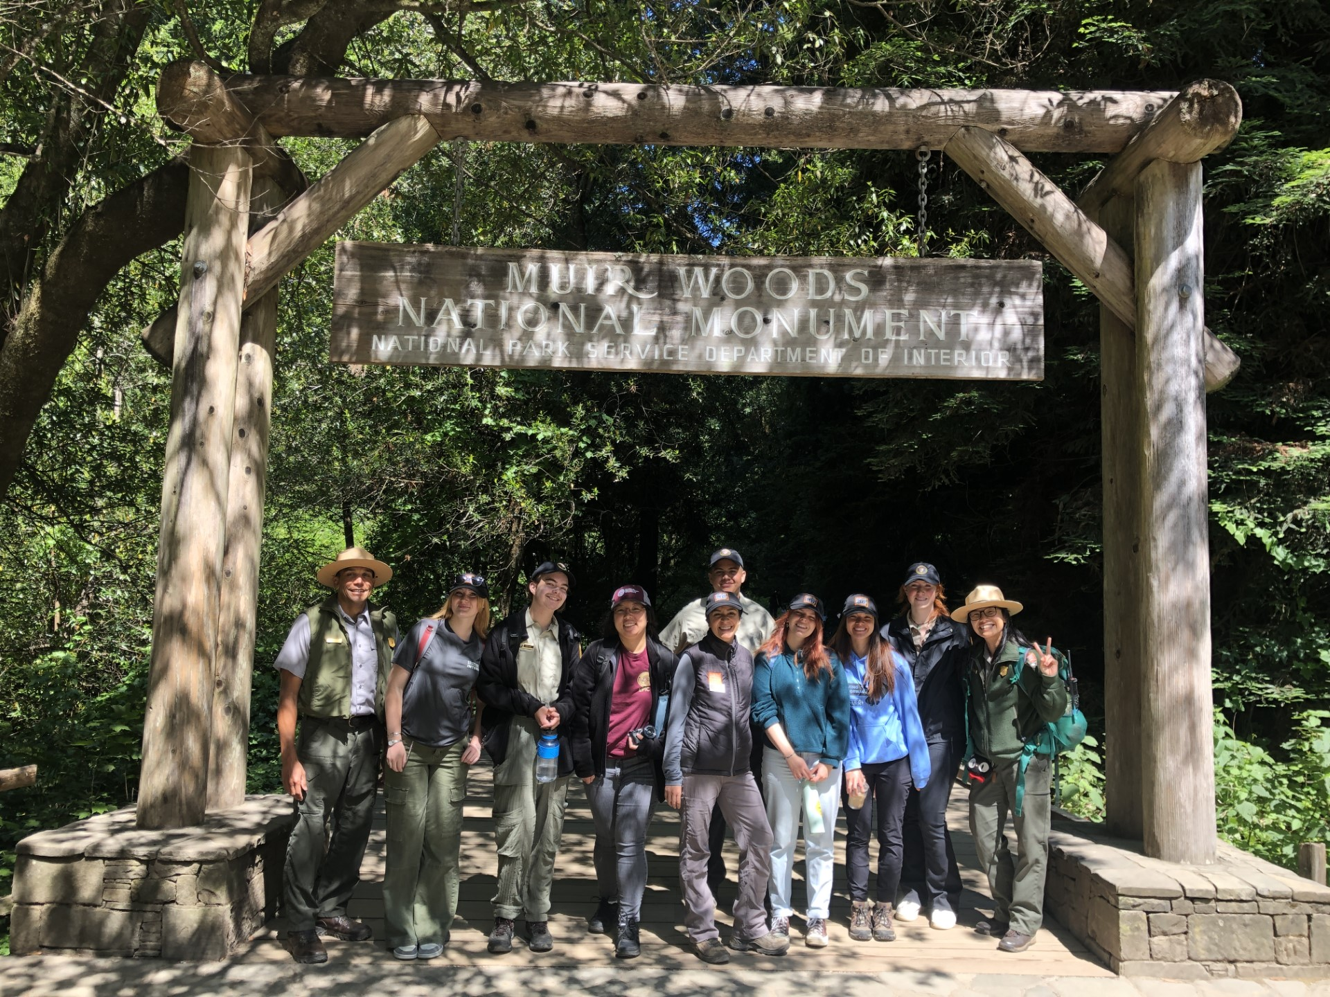
2024 Academic Internships
Photo Credit: Will Elder
Golden Gate National Recreation Area, Fort Point National Historic Site, Muir Woods National Monument
Notes:
Elsa: Denise will post our agenda for the day in the chat box. We'll start out by getting a brief program overview from Becca, and then I will go over some more specifics, the program goals, and timeline. We'll then move into the mentor presentation portion of the webinar, where we'll hear directly from the park staff mentors who are here to tell you more about their specific positions. Throughout the presentations, you can feel free to put all of your questions in the Q&A box, and our mentors will be around at the end to help answer them. All questions are great questions! We'll wrap up the webinar today by 4pm. To kick us off, I'll pass it to Becca to give us an overview of the program.
(Becca pastes in chat)
Today's Program
Welcome!
Program overview, goals, and timeline
Mentor Presentations; 3 categories
Student Q&A
Official program concludes

Slide 3
Program Details
Photo Credit: Paul Myers​
Program open to students enrolled at City College of San Francisco, San Francisco State, and College of Marin in all majors
Please note* You must plan to enroll for spring, summer, or fall 2024
May 29 – August 2, 2024; 10 weeks total
3 required orientation & onboarding days: May 29th, May 30th, May 31st
Part-time and Full-time positions available
Positions may be in-person or hybrid
Located in Marin, San Francisco, and San Mateo counties
$250/$500 weekly stipend
Academic credit/units available
Friday Workshop Series and additional enrichment opportunities outside of your specific internship are encouraged
Notes:
Elsa: The program is open to our three partner schools, City College of San Francisco, San Francisco State University, and College of Marin. To qualify for this program, you must be actively pursuing a degree, certificate in any major or have intention to transfer. You should be planning to enroll for spring, summer or fall 2023 classes. The program will run for a total of 10 weeks this summer, from late May to early August. There are 3 required onboarding and orientation days that interns are required to attend, which are Tuesday, May 29th, Thursday, May 30th, and Friday, May 31st. These days will likely be fully virtual, with possibility of an in-person session or two. There are approximately 18 positions available, which vary from part-time to full-time. Positions may be fully virtual or fully in-person, but most will be a hybrid of both. Positions are located in the 3 bay area counties our park touches, including San Mateo, Marin, and San Francisco counties. Academic Interns receive a weekly stipend of either $250 or $500 depending on their schedules, and the opportunity to earn academic credit. There are also a multitude of enrichment and training opportunities for you to participate in, some of which will be required and others encouraged!
Other benefits of participating in an internship include gaining real work experience, hands-on training, professional workforce skills, leadership skills and more. Working here in the park, you'll create a wide network of professionals who may be potential connections for future job opportunities!

Slide 4
Program Goals
Create immersive opportunities for young people to gain work and leadership skills through practical experience, interactive learning, essential skill building, and specialized training
Greater engagement of local youth who have been historically underserved in our national parks and public lands, particularly local youth of color, as well as from lower socio-economic means
Encourage and provide a ladder of learning and career pathways through community building, alumni engagement, and professional networking
Cultivate our future workforce and next generation of leaders
Offer transformative experiences that build deep connections to our public lands
Provide support to meet fundamental needs of park management and operations
Photo Credit: Jessica Weinberg
Notes:
Elsa: We have 6 focused goals for our internship programs here at Golden Gate. The first is what these internships are all about: Creating immersive opportunities for young people to gain work and leadership skills through practical experience, interactive learning, essential skill building, and specialized training. Another big one is greater engagement of local youth who have been historically underserved in our national parks and public lands, particularly local youth of color, as well as youth from lower socio-economic means. These internships encourage and provide a ladder of learning and career pathways through community building, alumni engagement, and professional networking. We are working to cultivate our future workforce and next generation of leaders, offer transformative experiences that build deep connections to our public lands, all while providing support to meet fundamental needs of park management and operations.

Slide 5
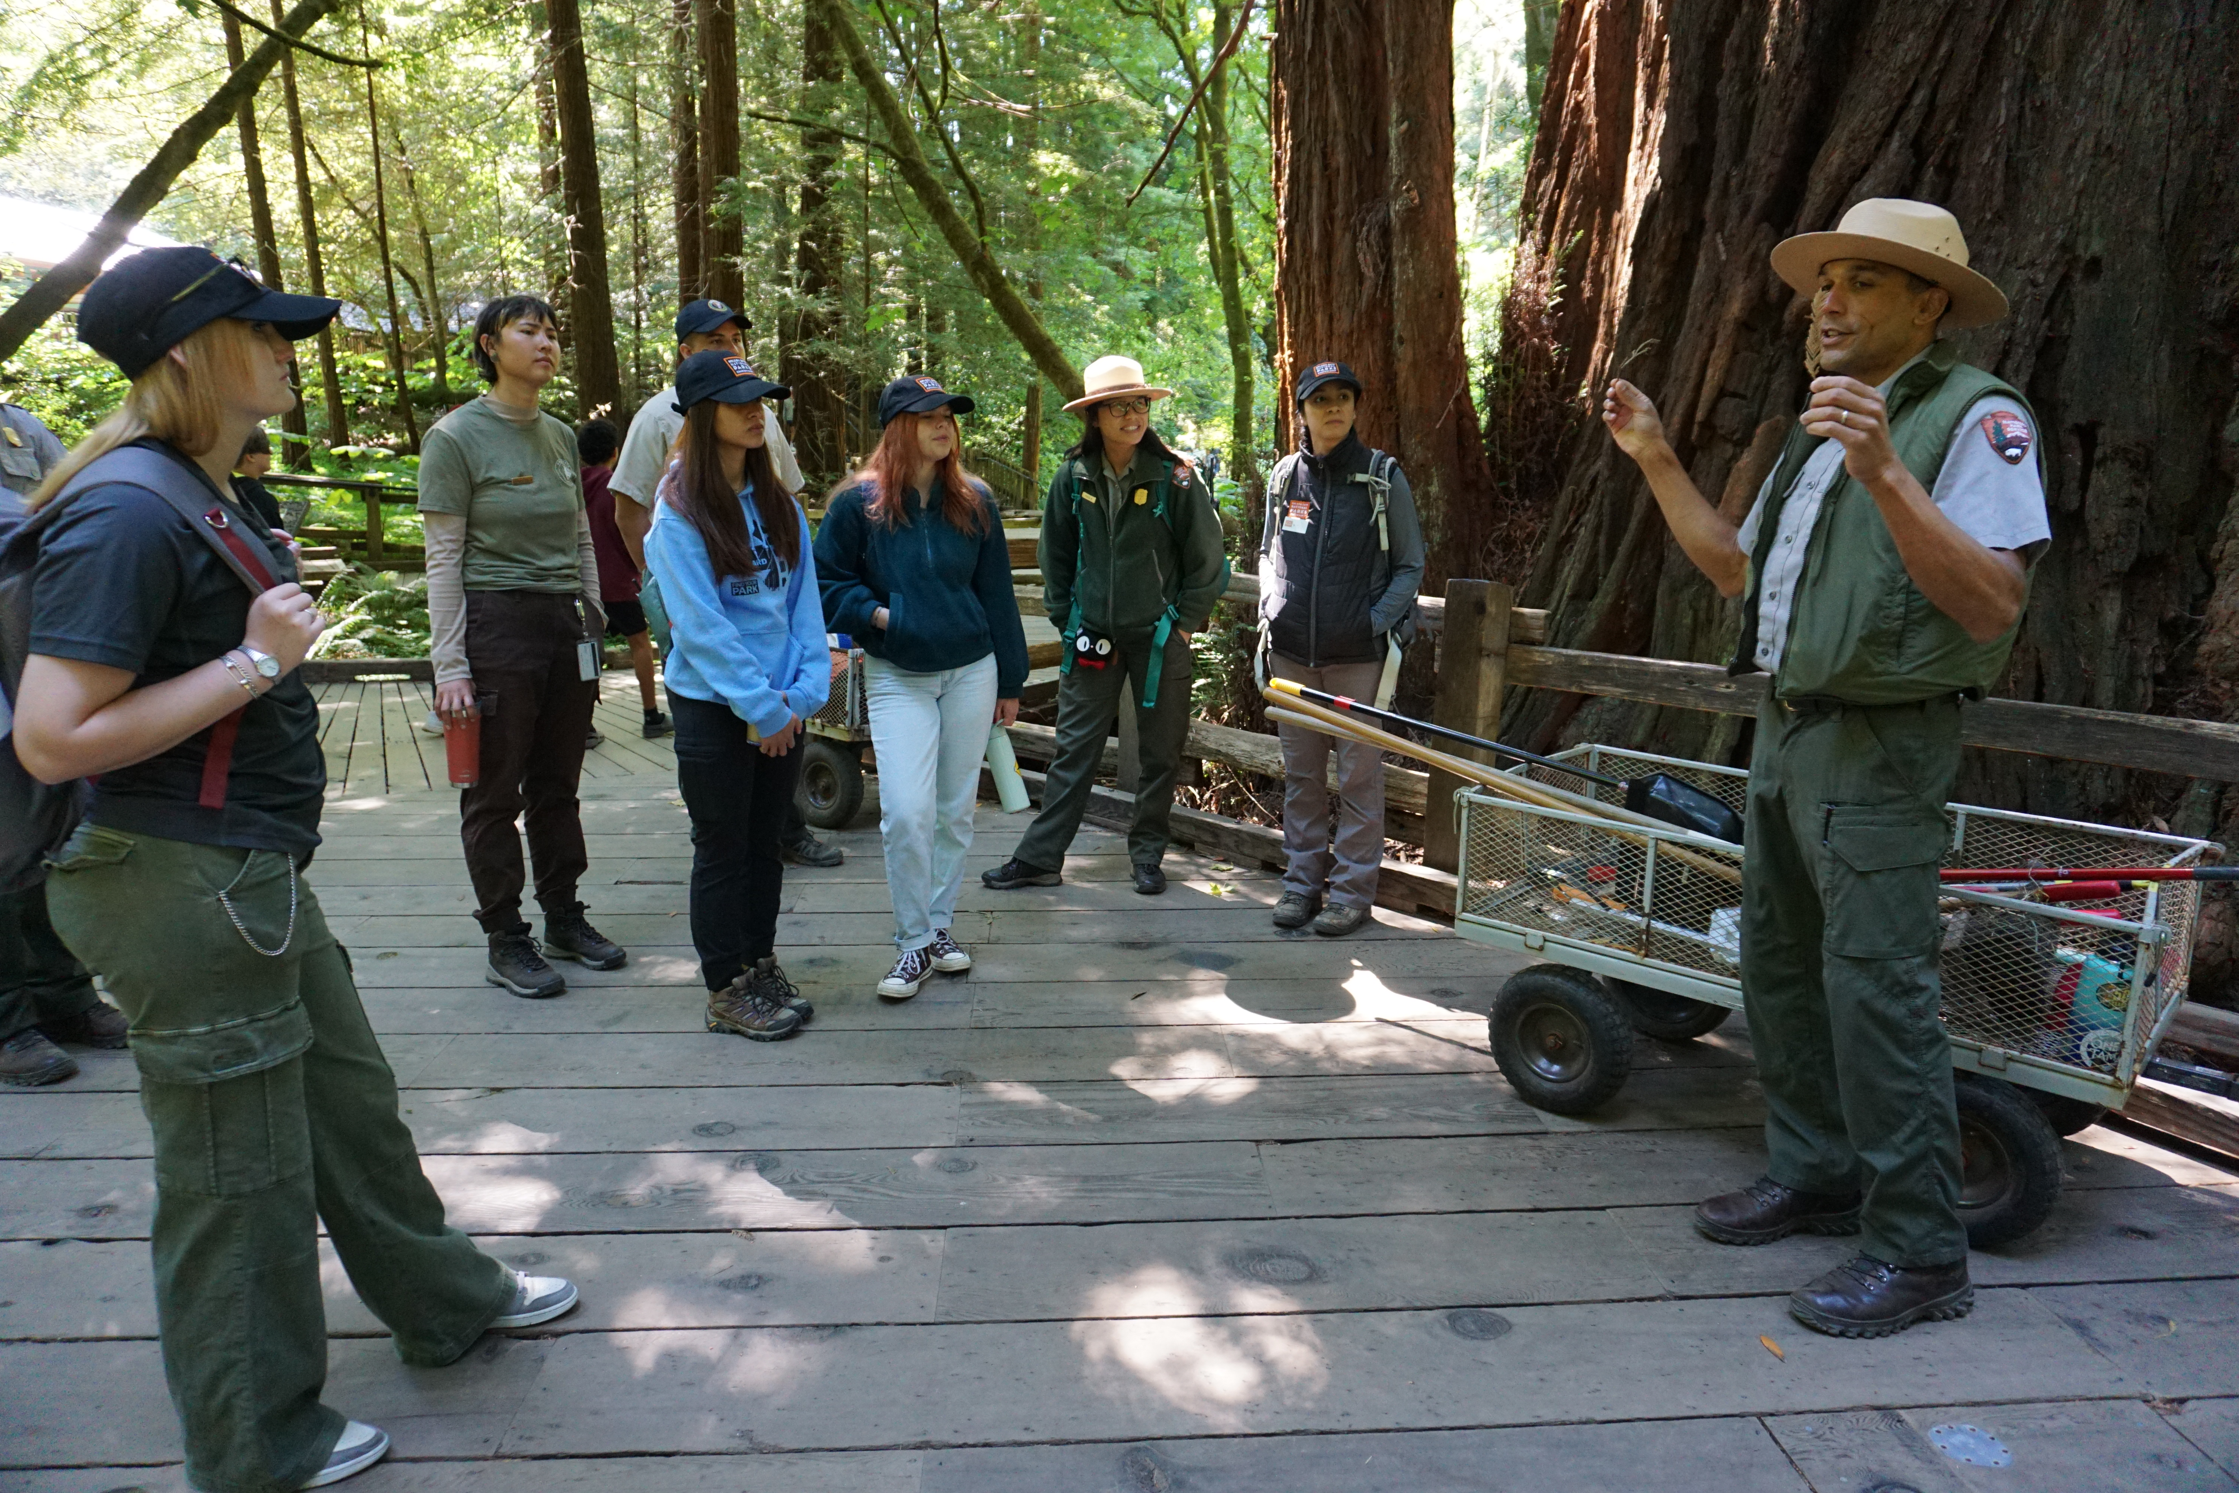
Mentor Presentations
Notes:
Elsa: We are joined today by all of the mentors who will be hosting Academic Interns this summer and they're here to speak to you directly! They are excited to tell you more about their positions and help answer any initial questions you may have.

Slide 6
Business Administration & Operations
Notes:
Mackenzie: Our first section today is Interpretation and Education, and Museum Programs. We'll kick off the presentations today with Maya presenting on her digital media position. Maya, over to you.

Slide 7
Business Administration Internship Doorey Chung | Revenue and Fee Business Specialist Jason Trollope | Realty Specialist
Want to learn about business and policy administration? Thinking about pursuing a graduate degree in business (MBA) or policy (MPA/MPP) administration?
Apply for the Business Administration internship!
In-Person or Hybrid Internship
Flexible for Part or Full-time
San Francisco, CA (Fort Mason)
Notes:
We are looking for an undergraduate that is interested in financial management, real estate development, contracts administration, organizational development, and /or public-private partnership development.
Duties of the internship will be flexible based on GGNRA needs at the time and the selected intern’s interests. Sample duties include:
Developing projects to implement or improve fee-based campgrounds
Supporting a proposal for public EV charging fees
Processing permits for commercial activities on federal property
Supporting development of park financial and project planning tools
Desired Qualifications:
Curious and enthusiastic
Analytically minded
Relevant majors or areas of undergraduate study include business administration / management, public policy / administration, accounting, finance, economics, etc

Slide 8
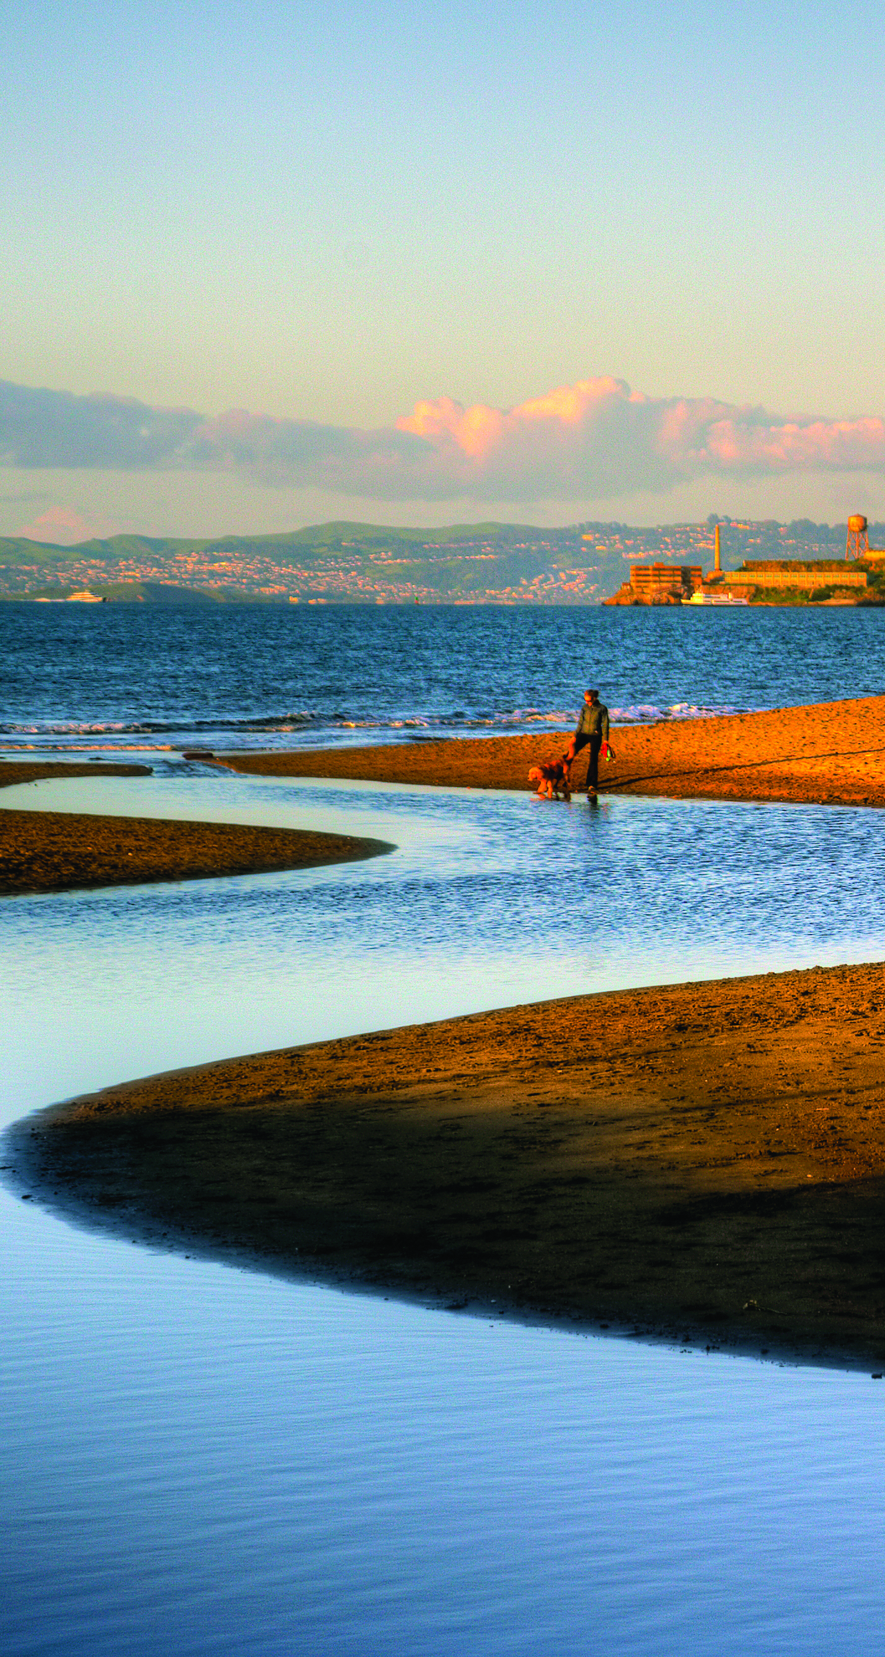
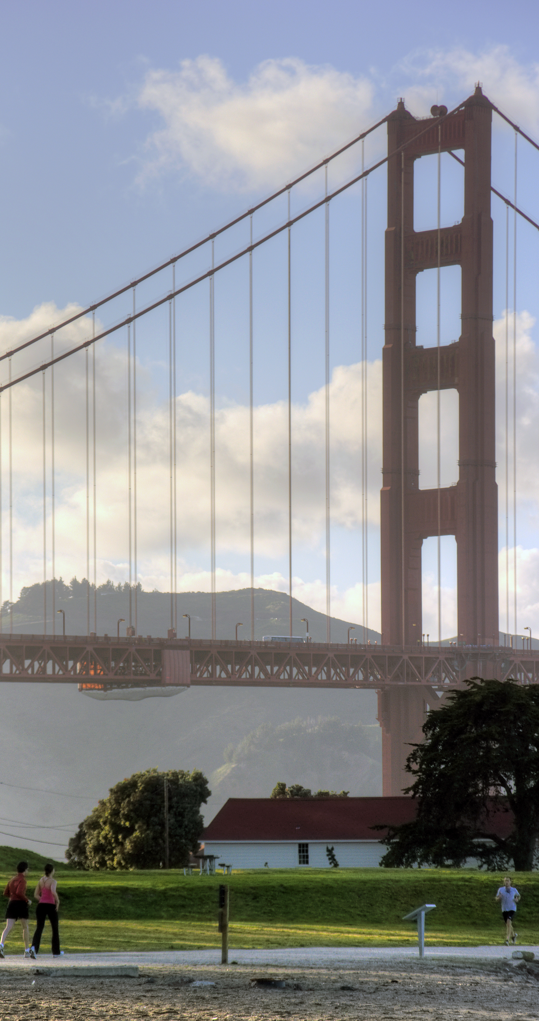
Facilities & Vehicles Administration Academic Internship Katharina McAllister | Operations Manager Facilities and Fleet
Historical Heritage and Operational Excellence:
Engage in the preservation and management of our cherished historical facilities, ensuring they remain vibrant hubs of cultural and educational significance.
From iconic landmarks to hidden gems, you'll play a vital role in safeguarding these treasures for future generations while optimizing their operational efficiency.
Your contributions will directly impact the seamless functioning of our operational infrastructure. You will support team members in fulfilling their roles effectively and contribute to our collective success.
Hybrid – requiring 3 days in the office

Slide 9
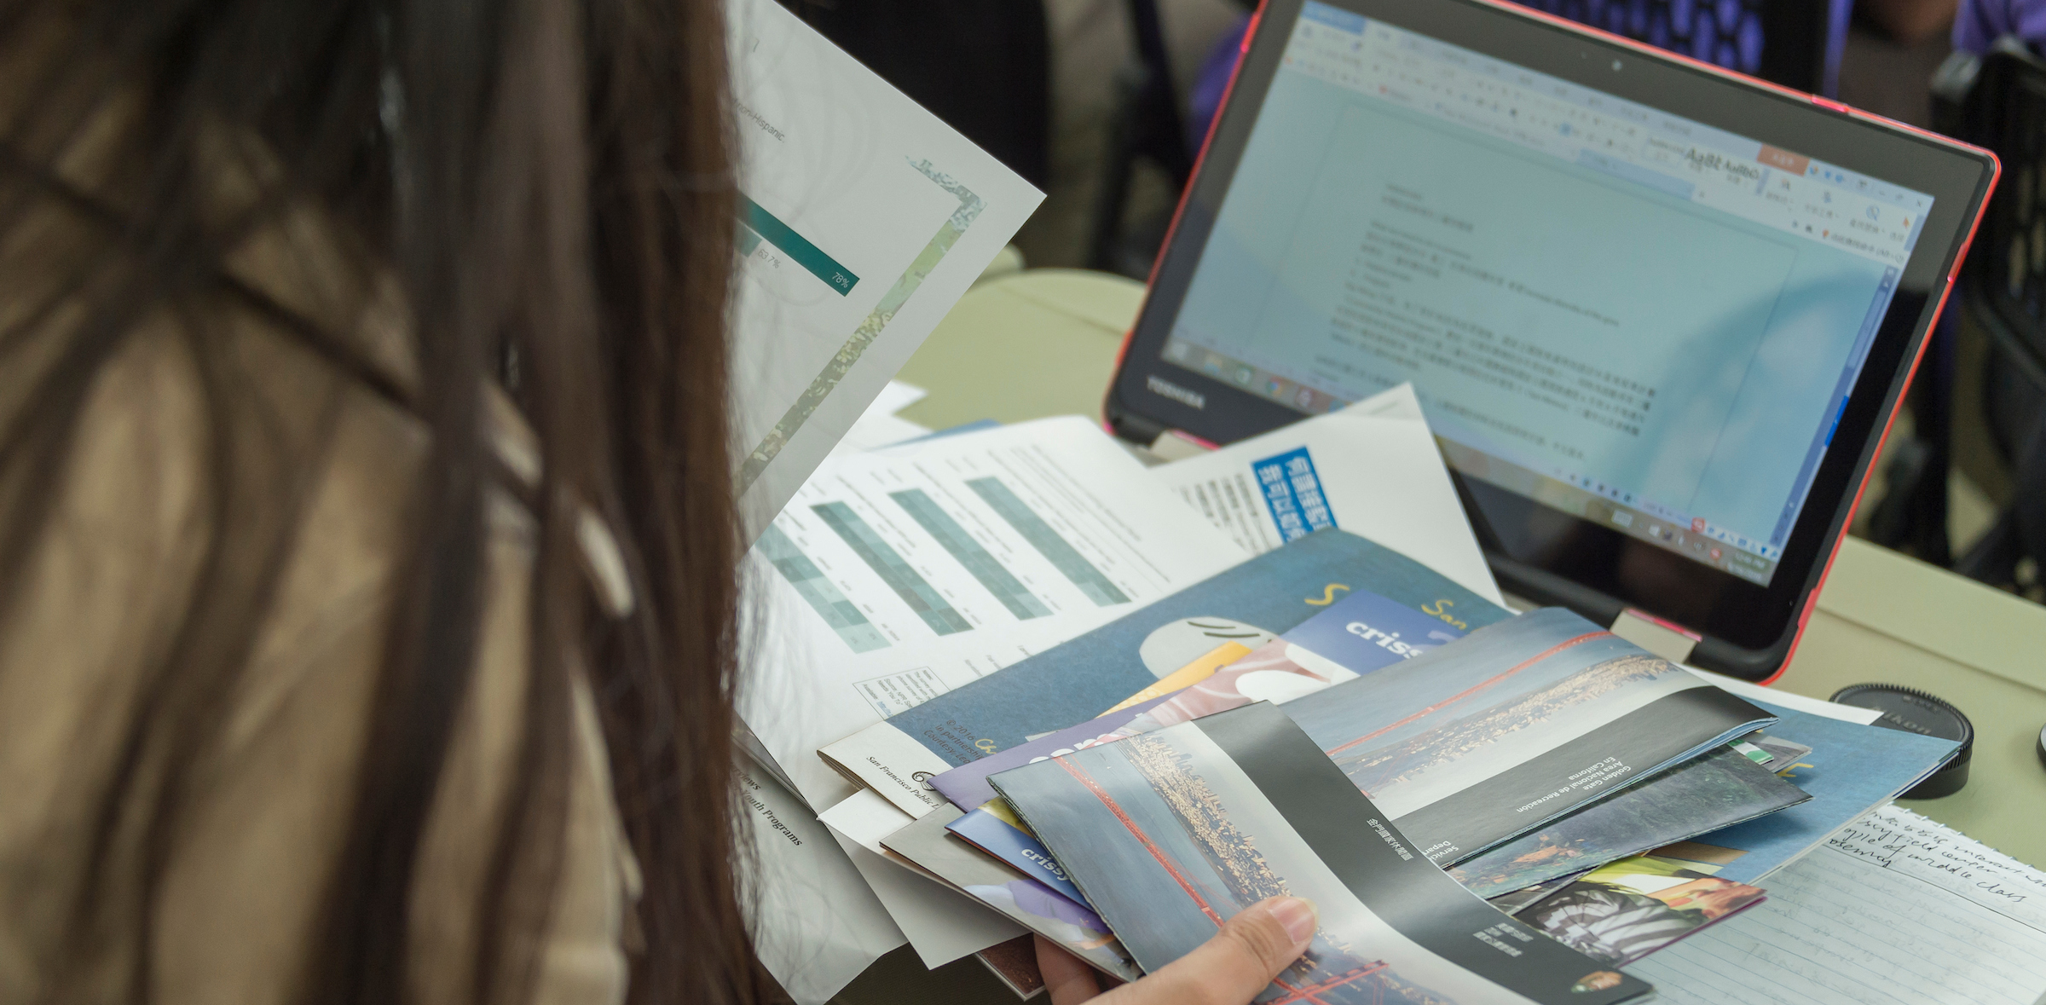
Public Affairs Internship Laura Elze | Public Affairs Specialist
Thinking about going into public affairs or communications? Want direct experience in civic engagement?
Full-time internship with mix of virtual & in-person duties at Fort Mason, San Francisco
Assist Public Affairs with messaging campaigns, short videos, & digital content.
Answer visitor requests for brochures, junior ranger badges and more.
Photos by Alison Taggart-Barone
Notes:
We are looking for a Public Affairs and Special Park Uses Intern who has excellent written and oral communication skills and can think on his/her/their feet. The intern will assist in developing content for multiple platforms to explain agency actions or policies that will increase understanding among internal and external audiences. In this position it is important to possess effective written and oral communication skills for interacting with park visitors, park partners, park staff and other stakeholders.
Working as part of a team, you will be provided with a supportive internship environment that introduces you (or reinforces your knowledge) to civic engagement, public outreach, media relations, and special park uses programs in national parks.

Slide 10
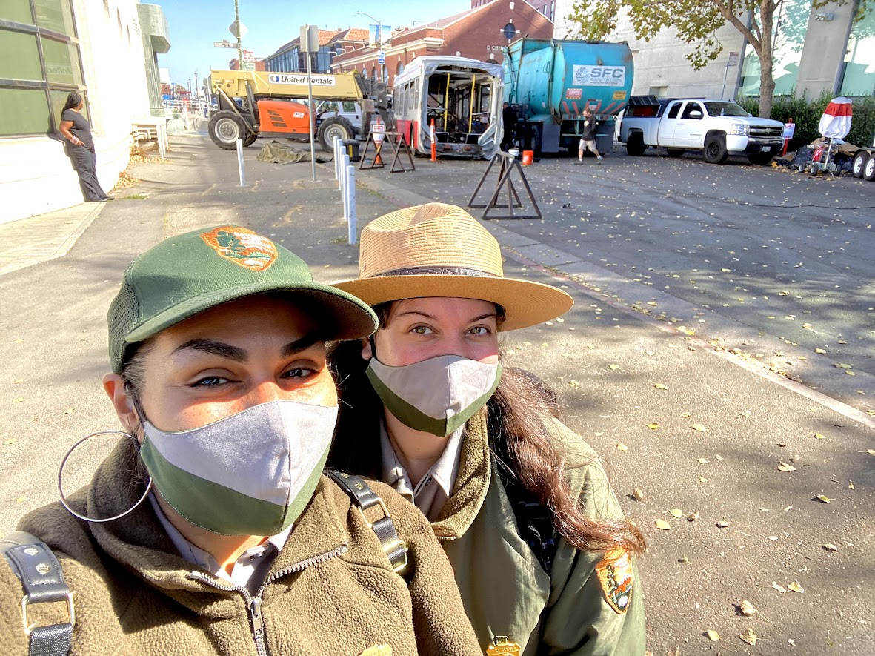
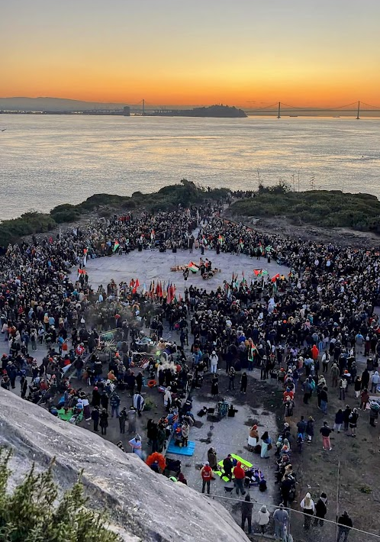
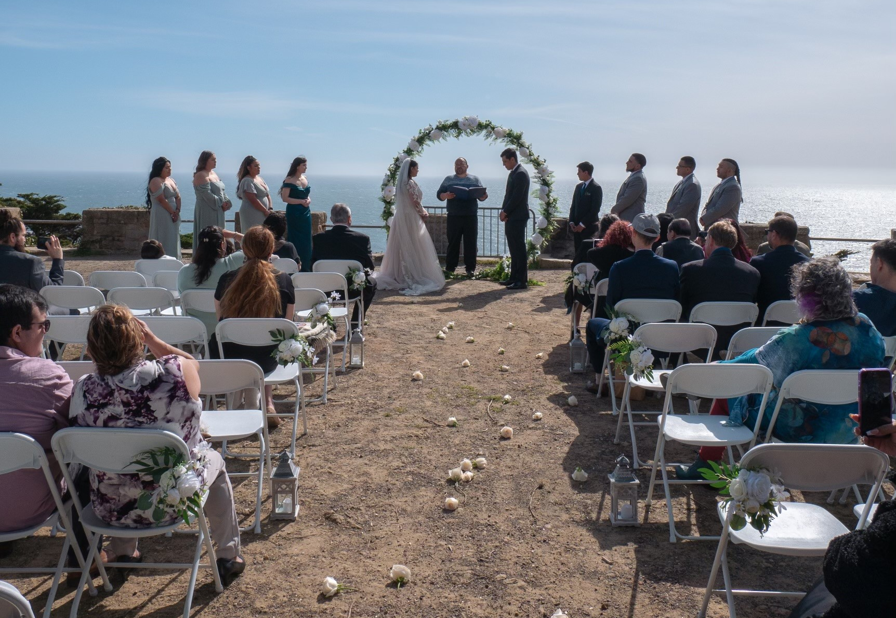
Special Park Uses Internship Alejandra Iraheta | Events Specialist
Do you love organizing and event planning? Are you looking to learn more about your local National Parks? If so, join our dynamic, fast paced team this summer!
Hybrid Full-time schedule: Monday-Thursday
Assist with online organization of files
Create maps for Event locations
Explore GGNRA sites
Opportunities to assist with permit monitoring

Slide 11
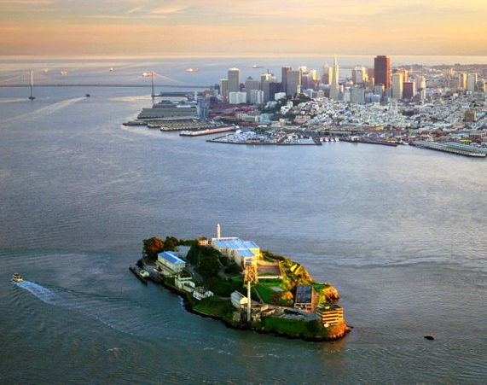
Operations Administration Academic Internship Michael Carr | Chief Operations Officer
Immersive Learning Environment:
Join a dynamic Operations branch at the forefront of innovation, where you'll gain hands-on experience crafting company-wide policies for purchasing, facilities, fleet management, and vendor contracts.
Dive into real-world challenges alongside seasoned professionals, accelerating your learning curve and preparing you for a successful career in operations management.
Hybrid – requiring 3 days in the office

Slide 12
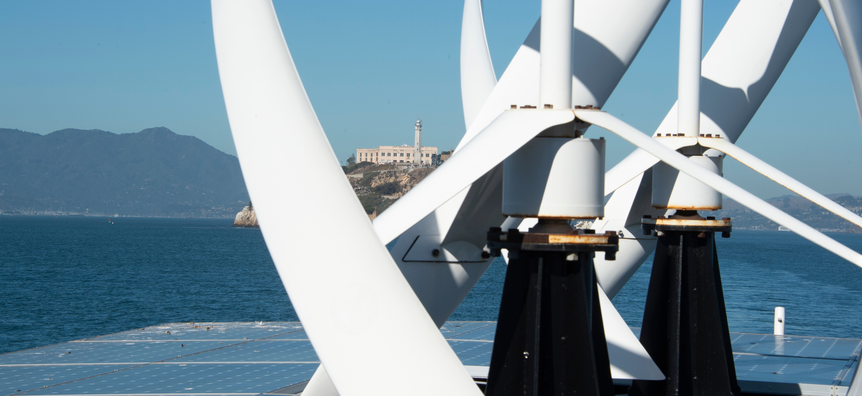
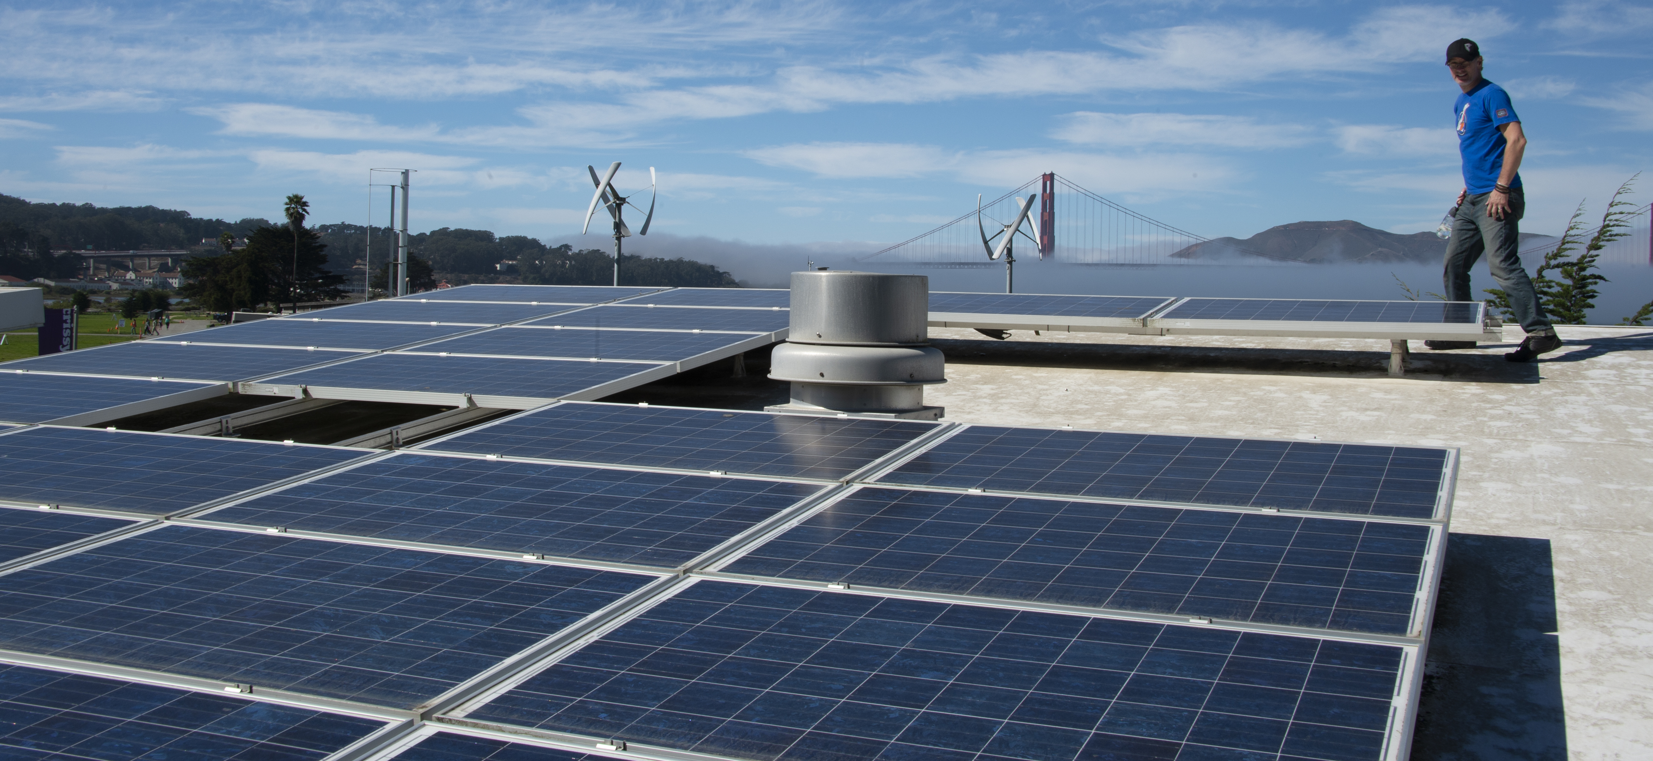
Sustainability Internship Laura Castellini | Sustainability Coordinator
Are you passionate about addressing climate change and learning how sustainability programs are managed in a National Park?
Virtual & In-Person Internship
Flexible for Part or Full-time
San Francisco, CA
Photo Credit: Alison Taggart-Barone
Notes:
We are looking for a Sustainability Intern that will work in the Planning and Environmental Programs Division of the Golden Gate National Recreation Area. The intern will assist with policy and planning for a range of sustainability projects and programs throughout the park.
A lot of the focus in Summer 2022 will be around climate change and sustainability education and outreach:
Written newsletter items on what the park is doing; helping plan guest speakers, maybe even help with a video production
Other opportunities may include working on sustainability projects related to energy and water conservation, transportation, or solid waste diversion
We are also having discussions about updating our Climate Change Action Plan, so you can be involved in policy discussions as well
I also plan to have a high school intern at the same time, so there may be some mentoring opportunities available as well.
Describe what the internship will be like day to day: combo of office and field work; some virtual and some in-person depending on covid restrictions
What are some skills that can be gained from this internship: planning, implementation, collaboration, communication
Why do you enjoy going to work everyday?
What is your favorite part of your job?
Sharing the challenges you might face and creative ways to tackle them
Share something you'd like students to know about the internship

Slide 13
Community Programs
Notes:
Mackenzie: Our first section today is Interpretation and Education, and Museum Programs. We'll kick off the presentations today with Maya presenting on her digital media position. Maya, over to you.

Slide 14
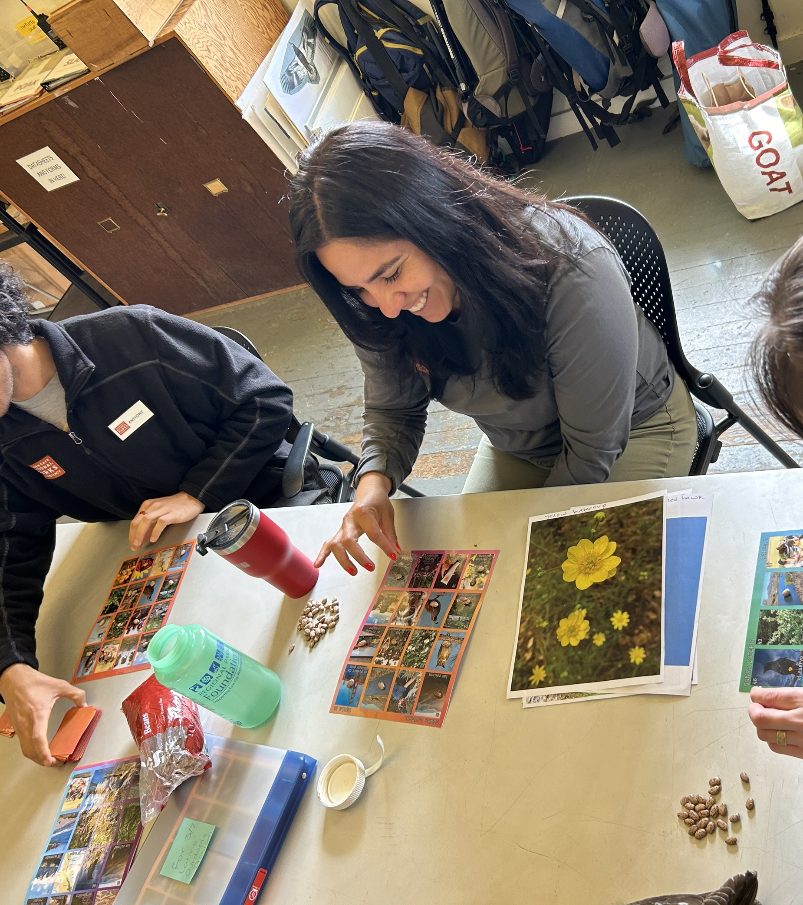
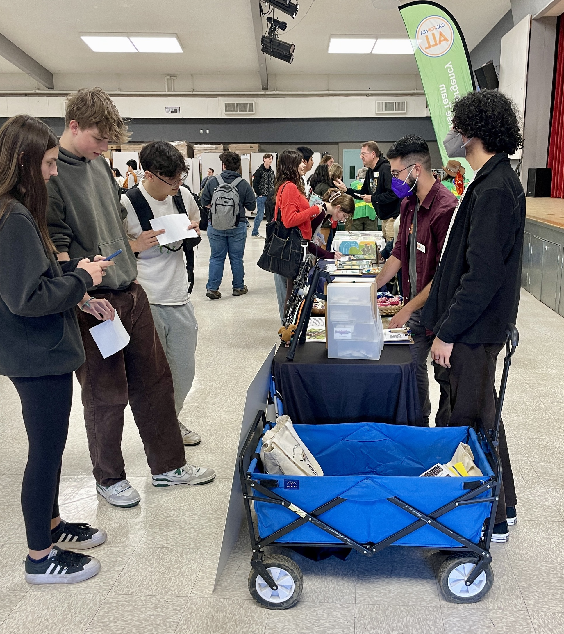
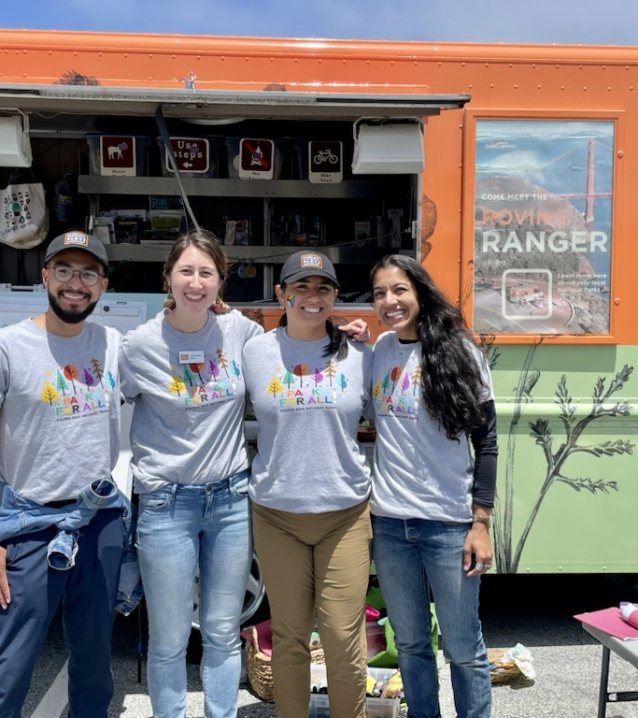
2 Bilingual/Community Engagement Internships Christian Trujillo | Community Engagement Program Manager Zaira Sierra | Community Engagement Program Manager
Are you looking to build your skills in community engagement and outreach through nature-based programs and initiatives in community spaces?
Work Schedule: Full-time, Tuesday - Saturday, 9 a.m. - 5 p.m.
San Francisco, Marin, & San Mateo

Slide 15
Community Outreach Fatima Colindres | Interpretation Park Ranger
Are you passionate about conducting recreational programming outdoors, working with local community groups and introducing urban audiences to their national parks?
Full-Time (32-40 hours/week)
Wednesday to Saturday
Saturdays Required
Mostly In-person, Some Virtual
Research and Project Time
Presidio Tunnel Tops, Crissy Field
Photo Credit: Mariajose Alcantara
Notes:
Academic Internship Webinar 2 min script
Script is 1:45 long / 2/18/22
Hello everyone, my name is Fatima Colindres, I am a park ranger with the Community Outreach team at Golden Gate National Recreation Area. I would like to invite you all to join our team this summer.
If you would love an opportunity to practice your public speaking skills, storytelling, and learn to work with diverse communities in an outdoor setting, then this is the internship for you.
The Community Outreach team partners with community groups to connect new and underserved audiences to our beautiful park sites. We provide transportation, recreational opportunities, and interpretive programs.
This summer we will be collaborating and partnering with the San Francisco Public Libraries and with the YMCA to bring and inspire diverse age groups to get outdoors.
So, if you have ever wanted to work in the Golden Gate National Recreation Area but was not sure what site to choose, then join our team this summer, because our team brings the park to the people and the people to the park. Sometimes we deliver programs at community sites, and we also bring participants to multiple park sites in Golden Gate National Recreation Area, like Alcatraz, Muir Woods, Presidio, Crissy Field, Fort Point and Marin Headlands, just to name a few. And we look forward to the grand opening of the new Presidio Tunnel Tops this summer as well!
I hope to see you soon as part of our National Park Service family with the Community Outreach team.

Slide 16
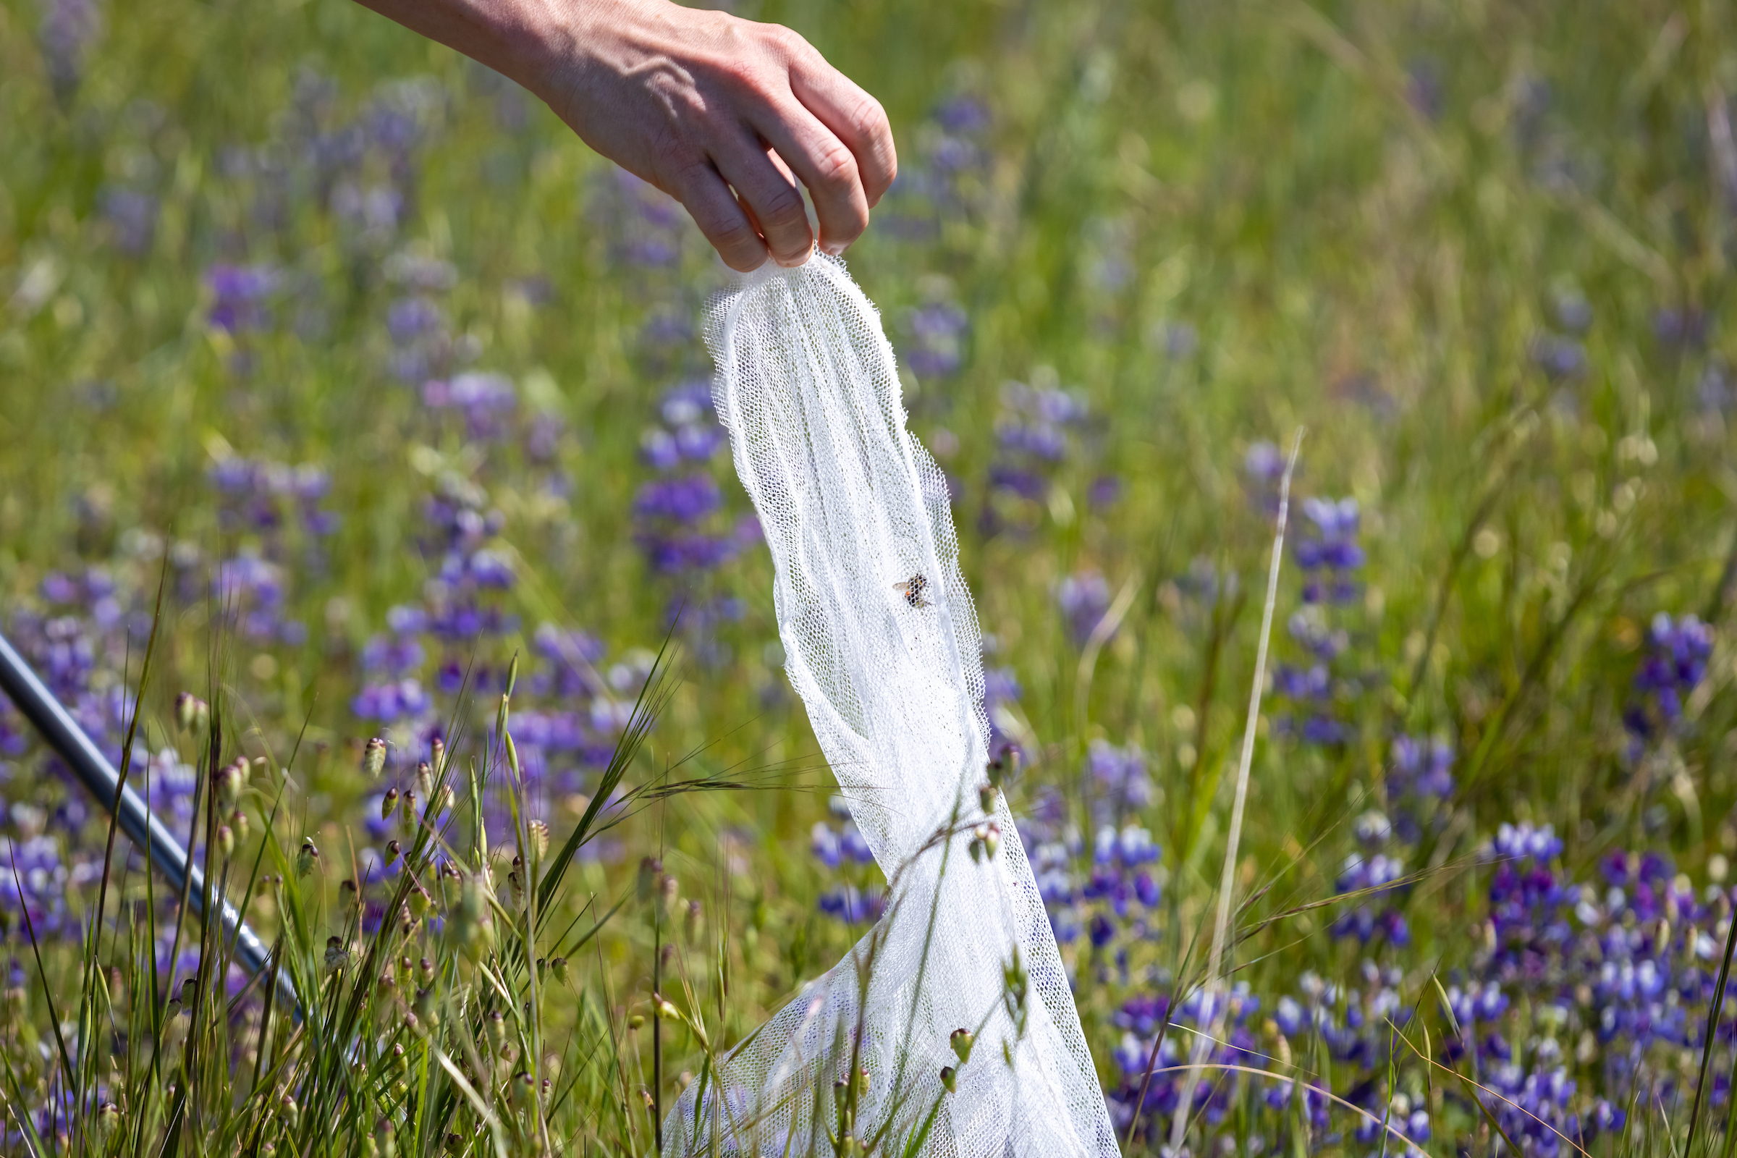
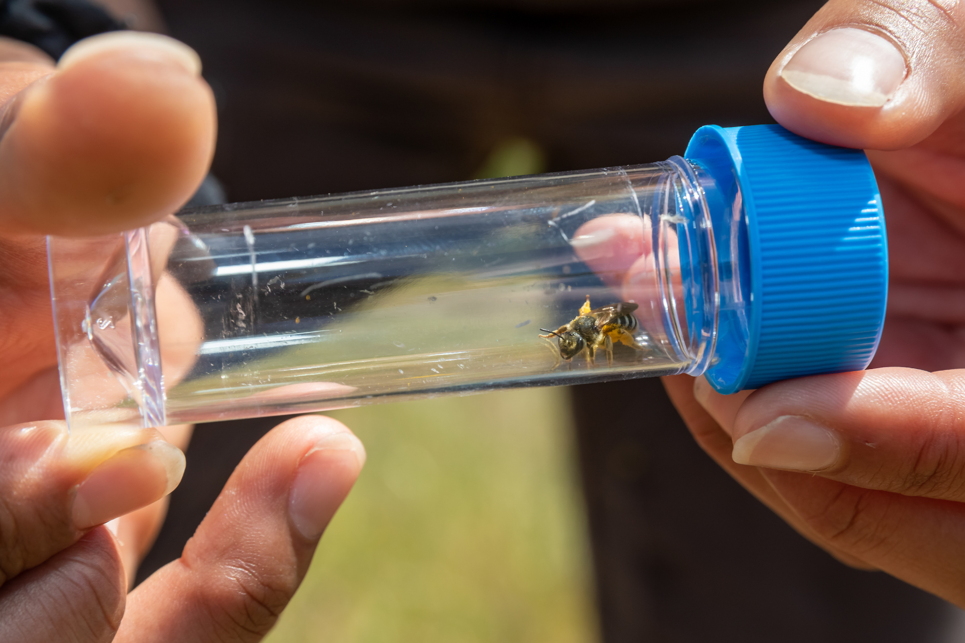
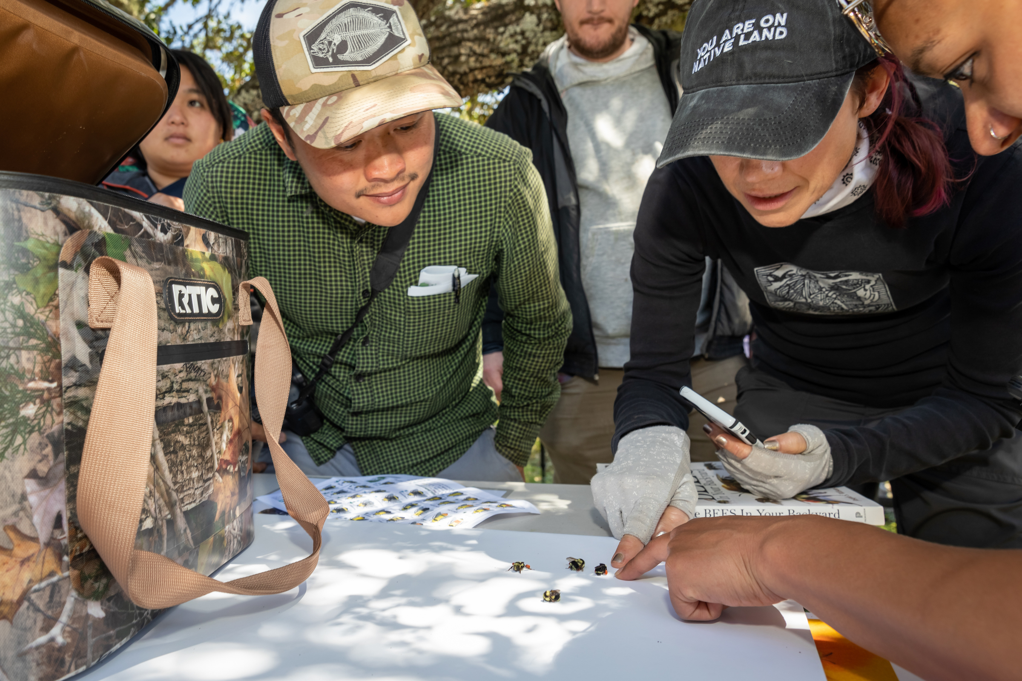
One Tam Community Science Internship Sara Leon Guerrero| Program Manager
Are you interested in bees, Mt. Tam, and sharing appreciation for nature and science with all kinds of people?
Hybrid: One Tam office in San Rafael and various locations across Marin County
Full-time: Tue-Sat, 8am-4pm
Support Tamalpais Bee Lab volunteer programs
Engage in community science
Learn how to identify plants & native bees
Conduct bee surveys on & around Mt. Tam

Slide 17
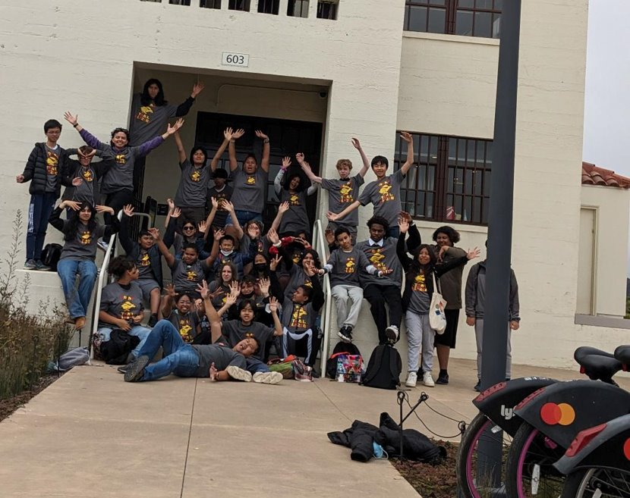
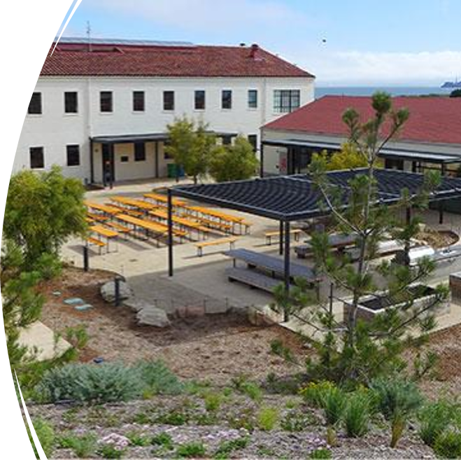
Youth Programs Internship Mark Yanez | Senior Operations Manager
Interested in working at a youth & community center located in a national park and centers social and environmental justice?
Help capture photos of the three main summer programs (UTB, LINC, QBBA)
Learn about logistical support for a youth and community center
Shadow summer program on camping trips and special field trips
On-Site & In-Person: Crissy Field Center located at Tunnel Tops in the Presidio
Full-time: Monday-Friday, 8am-4pm or 9am-5pm

Slide 18
Historic Preservation
Notes:
Mackenzie: Our first section today is Interpretation and Education, and Museum Programs. We'll kick off the presentations today with Maya presenting on her digital media position. Maya, over to you.

Slide 19
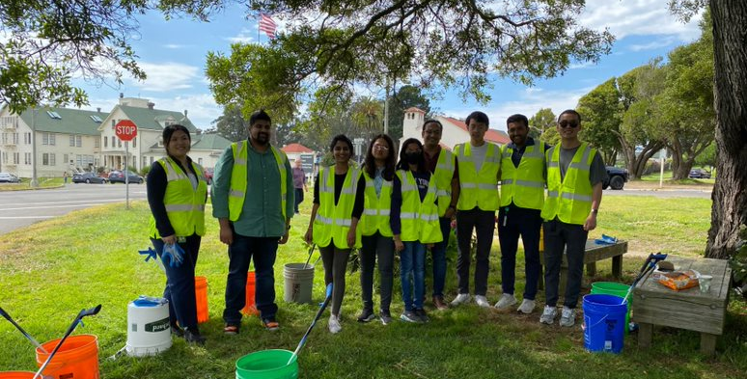
Historic Landscape
Ruben Limon | Gardener Leader
The Fort Mason and Sutro Heights Park historic gardens are looking for an intern interested in learning the daily operations of a Landscape management program in a park atmosphere.
Sustainable gardening
Visitor engagement
Volunteer program management
In-Person Internship
Part-time or Full-time
San Francisco, CA

Slide 20
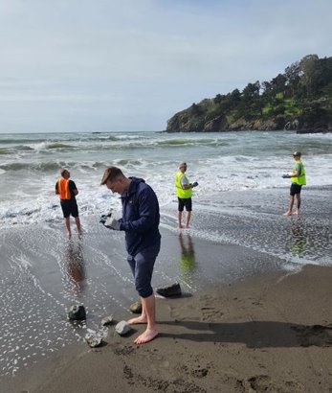
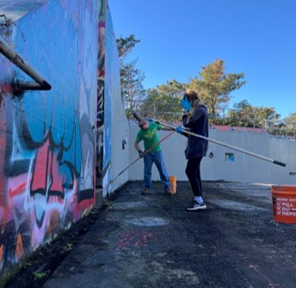
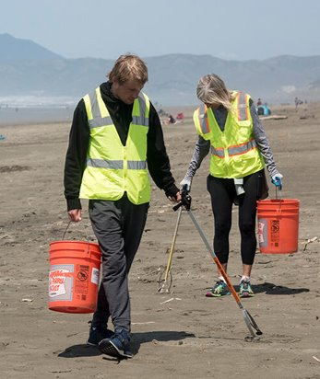
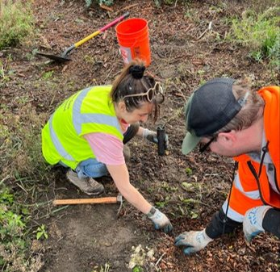
Maintenance Volunteer Program Internship Roland Schwichtenberg | Maintenance Volunteer Coordinator
Work with people from all walks of life
Opportunity to network
Receive training in several marketable subjects
Program and policy implementation
See all the park & work in amazing locations
Resume building
& more!

Slide 21
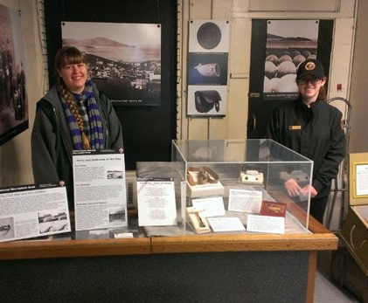
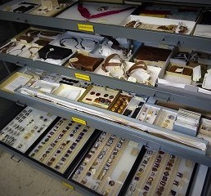
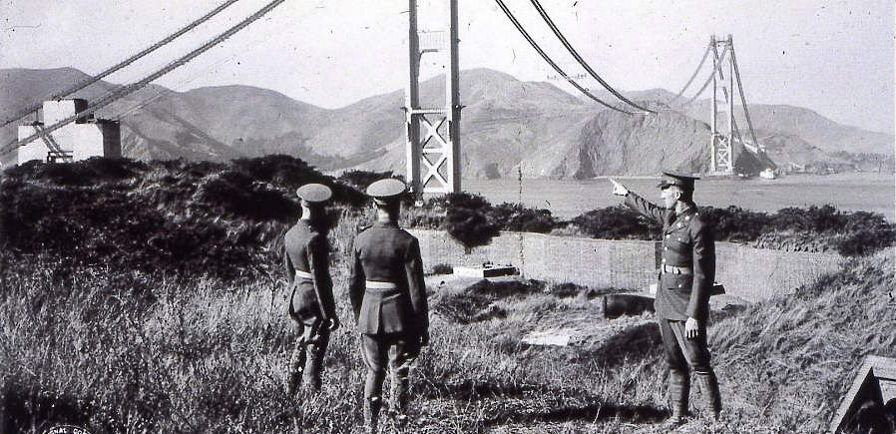
Museum Program Amanda Williford | Supervisory Curator
Do you have a strong love of history and want to get hands on experience with historic objects and archives? Want to learn how and why the GGNRA keeps museum collections?
In-Person Internship
Some virtual activities
Part-time
San Francisco, CA
Photo Credit: NPS Archives
Notes:
The GGNRA Museum Program is seeking a student intern to assist with the numerous responsibilities of maintaining the large and wide-ranging collection held by the park. Working as part of a dedicated team, the intern will be provided with the opportunity to learn about and participate in a highly diverse work environment with other museum professionals.
This internship will include learning and implementing professional standards of museum care, maintenance, and management. The incumbent will gain knowledge in the requirements and policies the NPS must follow for acquiring and processing objects into the permanent museum collection. Outreach opportunities will demonstrate ways museum and archival collections are used to interpret and preserve the park’s history as well as how the Museum Program motivates the public and park staff to continue researching their own interests in history.

Slide 22
Visitor Services Programs
Notes:
Becca facilitates this section

Slide 23
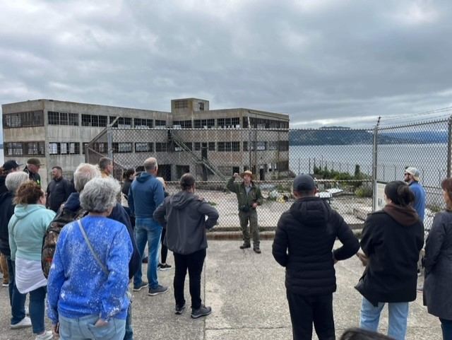
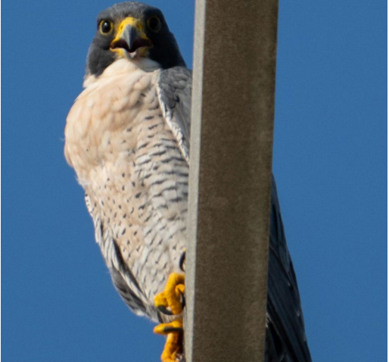
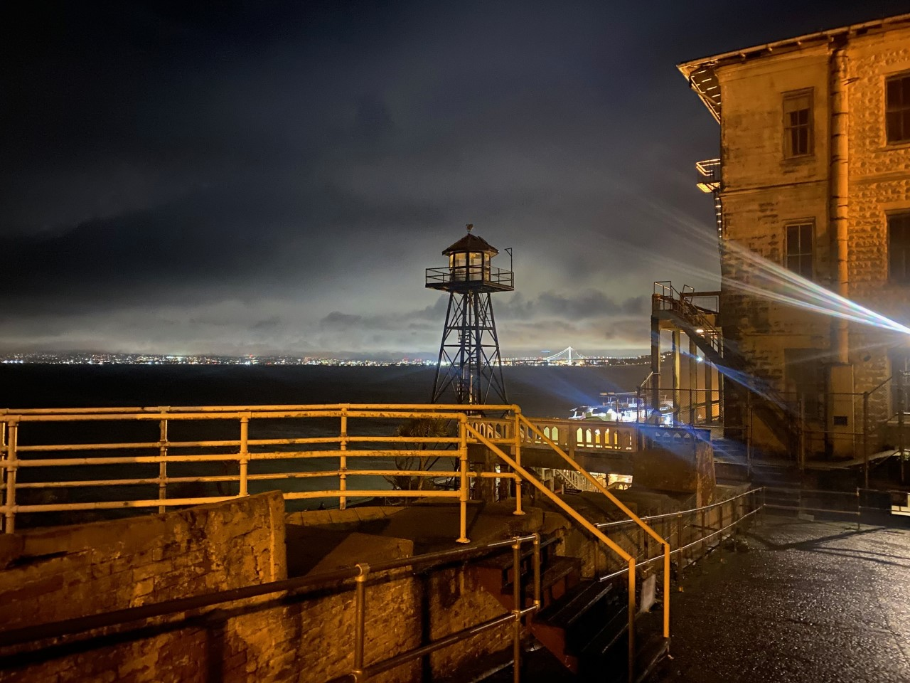
Alcatraz Historical Interpretation Roger Fang | Park Ranger Jeff Mc Kinney | Park Ranger
The Alcatraz Ranger team is looking an intern that:
Enjoys working outdoors
Is passionate about teaching history
Is comfortable interacting with crowds of park visitors.
As an Alcatraz intern, you will get to:
Learn about Alcatraz history, seabirds, and the gardens of Alcatraz
Develop skills with public programs and pop-up programming on island
Details:
In-person Internship
Full-time and Part-time Available
Ferry to Alcatraz departs from Pier 33 Daily

Slide 24
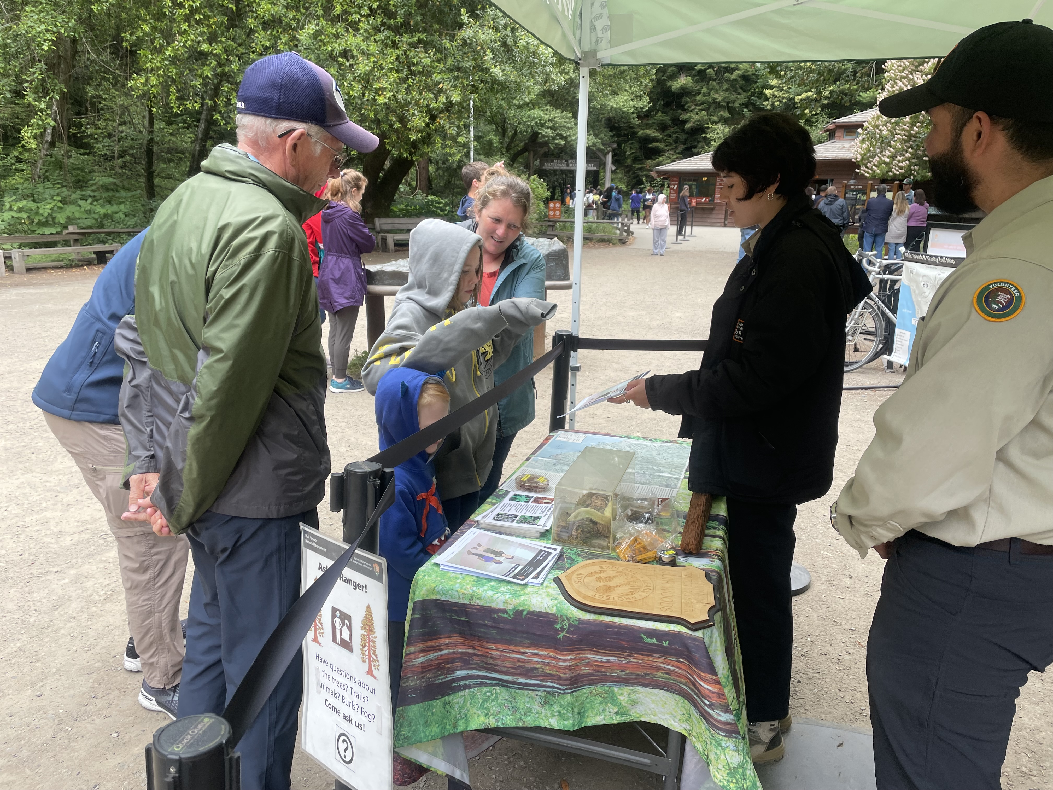
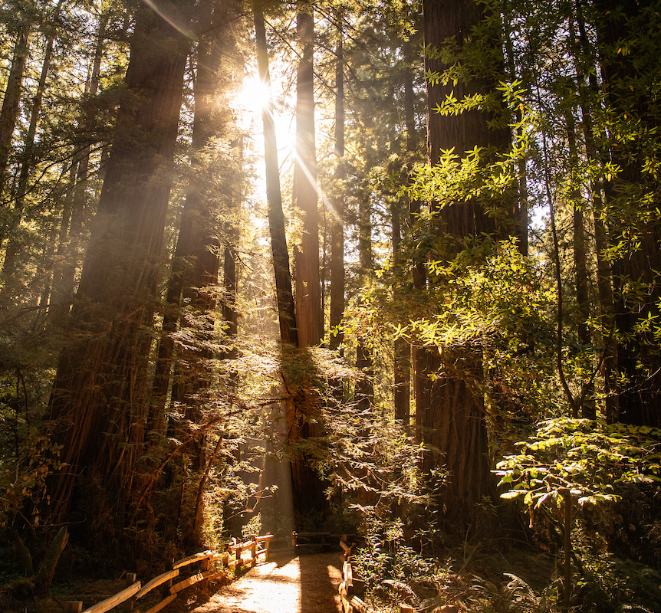
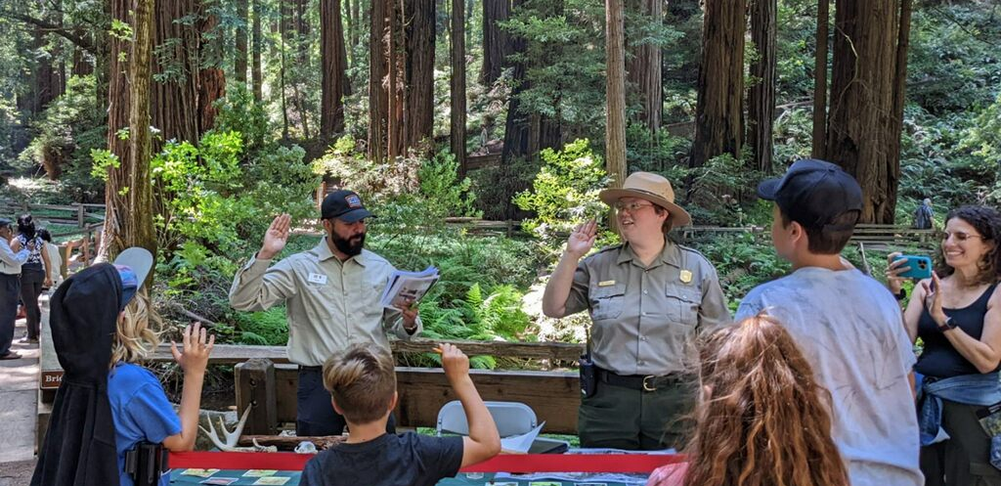
Muir Woods Visitor Services Interpretation Internship Adrian Boone| Interpretation Park Ranger Have you ever thought about being a Park Ranger, working outdoors educating the public in conservation, natural resources, and public speaking?
Helping visitors plan their trip, working with local community groups doing volunteer projects, and introducing urban audiences to our national parks?
Swearing in Junior Rangers
Conducting 15-minute ranger talks covering ecology, history, and cultural resources.
In-Person Internship
Full-time
2 positions available
Muir Woods National Monument, Mill Valley, Marin County.
Photo Credit: Paul Myers/Adrian Boone
Notes:
Hi,
My name is Adrian Boone, I’m a Park Ranger and Volunteer Coordinator here at Muir Woods National Monument. Muir Woods is the largest old growth redwood forest next to a big urban population city of San Francisco in the world. We work in a fast-paced environment, where we have a visitor front desk orientation station where we orient visitors on trails of the park, swear in junior rangers, and ensure people are following park rules.
The summer months are the busiest time of year at Muir Woods, the site sees over 1 million visitors a year, with parking often sold-out weeks in advance. Other duties here are answering the phones in the office with visitor questions, walking and roving park trails, and doing 15-minute Tree Talks, discussing the ecology of redwoods, salmon habitat and restoration work being done in the park, and the history of how Muir Woods became a monument. In this position, you would get to learn ways to communicate with people on how best to protect park resources and be able to inform them on why we have park rules in place, by having an increased knowledge of the fragile park resources.
Some of the things I like most about working here at Muir Woods is being outside with the giant trees, to hear the water in the creek flowing, and meeting people from all over the world, and seeing their expression and excitement when they see the giant coastal redwoods for the first time. I also enjoy the fact that I get to learn every day more about the unique plants and animals here in the park, and also the long human history dating all the way back to the Coast Miwok Indian Tribe to Spanish colonization.
If you enjoy being outside, learning and sharing with others the natural and cultural history of the Bay Area, and working with visitors from all over the world, in a fast-paced work environment, then please apply for the Muir Woods Visitor Services Academic Intern position.
Thank you!

Slide 25
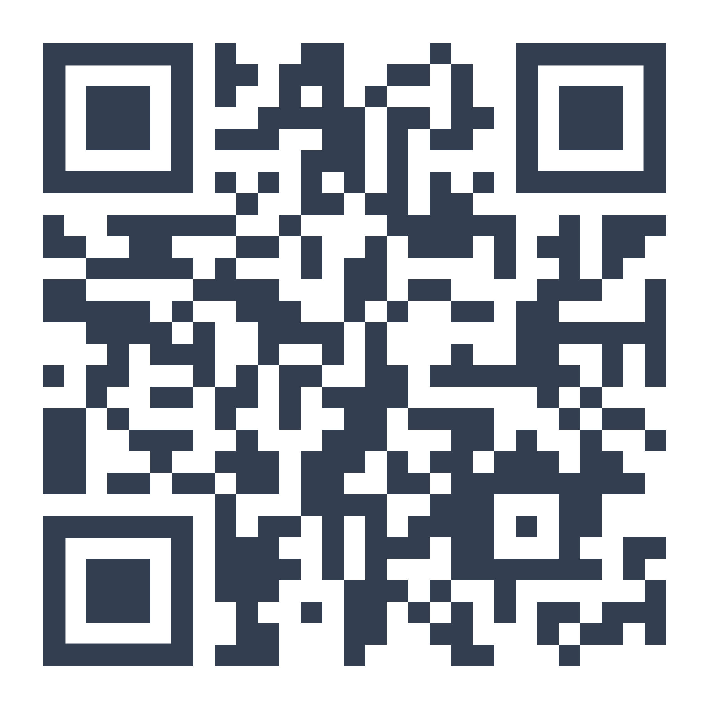
Application Process and Next Steps
APPLICATIONS OPEN NOW – Due April 1st at midnight!
See available positions on our website:
parksconservancy.org/internships/academic-internship-program
SUBMIT online application form
(cover letter & resume optional)
Notes:
Mackenzie: Alright, that concludes the mentor presentations for today! Now, you might be wondering, so how do I apply to these awesome positions? Well, here are the details! Applications are open until March 24th at 5pm! First, you can find the list of available positions and their descriptions on our website at parksconservancy.org/academicinternships. You can choose to apply to up to 3 positions. Once you've decided which you're most excited to apply to, you'll submit the online application form as well as email your resume and cover letter to academicintern@parksconservancy.org. We are asking that you email these in a single PDF file if possible. Only one cover letter is needed if you're applying to multiple positions – just state which positions you intend to apply to in the letter.
We'll be following up after this webinar with all of this information, so don't feel like you need to rush to write it all down!

Slide 26
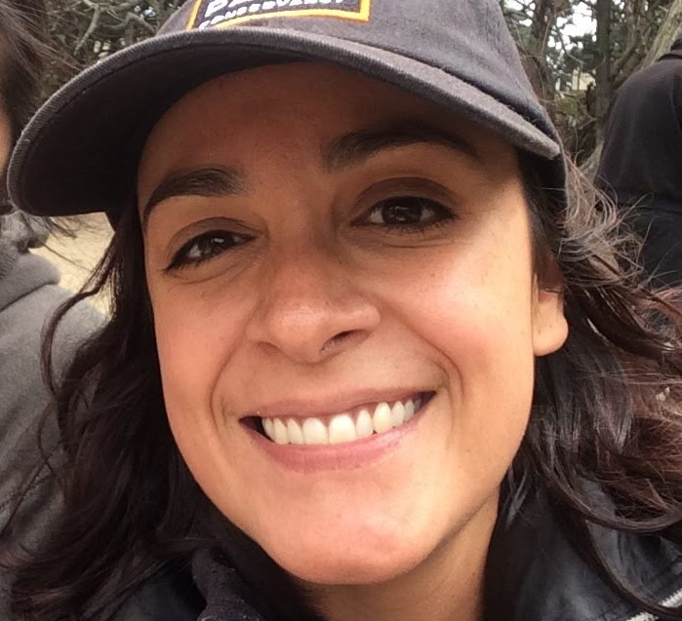
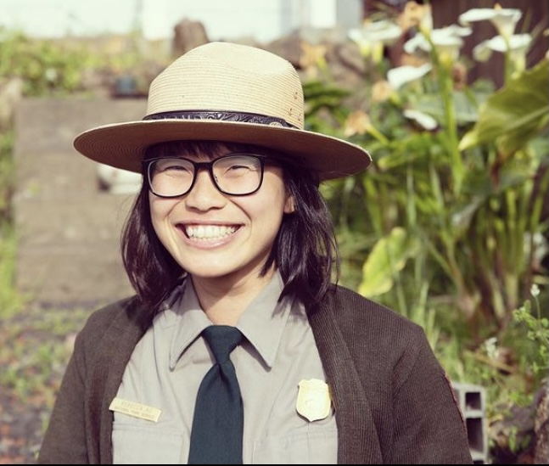
Thank You!
Elsa Calvillo: Park Internships Program Manager |Golden Gate National Parks Conservancy
ecalvillo@parksconservancy.org
Rebecca Au: Volunteer & Internship Specialist | National Park Service
rebecca_au@nps.gov
Academic Internship Program
Website: parksconservancy.org/internships/academic-internship-program
For Future Opportunities
Follow us on Facebook, Instagram, and Twitter: @parksconservancy ; @GoldenGateNPS
Notes:
Mackenzie: I'm excited to see a majority of you will be applying! If any questions come up while you're putting together your application, please don't hesitate to reach out. Here you'll see our contact information. Again, my name is Mackenzie, and you can reach me at msegraves@parksconservancy.org. You can reach Rebecca at rebecca_au@nps.gov. We encourage you to check out the Frequently Asked Questions page on our website, as your question might be listed there. For general questions, feel free to email academicintern@parksconservancy.org. If you have a question for a specific mentor, you can send it into that email address and I will pass it onto the correct person or get the answer for you. You can also follow us on social media at those handles listed for other opportunities and ways to engage with the park.
Again, we will be following up with an email containing all of this information and how to apply very soon! Thank you for attending today and we hope you apply! And of course, thank you to all our outstanding mentors who presented; we wouldn't have these amazing opportunities without you. Bye everyone!

